Slide 1
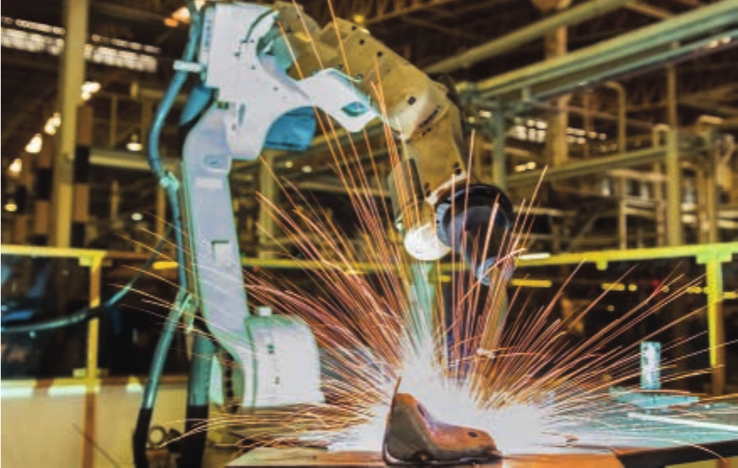
Automated systems
IGCSE Computer Science 0478 | 6.1
1
Notes:
Covers 0478 syllabus 6.1: how sensors, microprocessors and actuators work together in automated systems, and their advantages and disadvantages in industry, transport, agriculture, weather, gaming, lighting and science. Worksheet questions come from the 0478 question pack supplied (2024-2026 papers), with official marking points in the answer key.

Slide 2
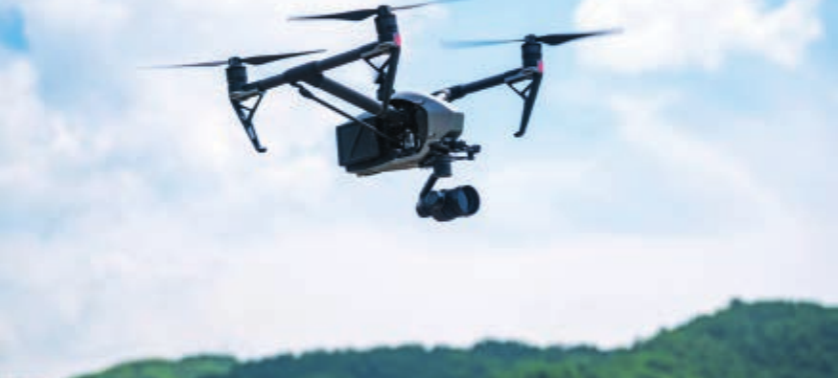
Recall test: sensors (topic 3.2)
Starter activity
Worksheet Task 1 covers... | Marks
Match six sensors to what they measure | 6
State what is meant by a microprocessor (Feb/March 2026) | 1
Is a sensor input, output, process or storage? (Oct/Nov 2025) | 1
1
Closed book
No notes or slides - 5 minutes, then swap and mark.
2
Notes:
Worksheet Task 1, closed book, 5 minutes. Sensors were taught in 3.2; every 6.1 question assumes students can pick the right one. Two parts are real exam questions: 0478/12 Feb/March 2026 (drone) and 0478/13 Oct/Nov 2025 (air conditioning).

Slide 3
In this lesson, you will
Objectives
Define an automated system
Describe how sensors, a microprocessor and actuators work together to control a process
Choose suitable sensors for a given scenario
Give advantages and disadvantages of automated systems in industry, transport, agriculture, weather, gaming, lighting and science
Use exam technique to write full-mark answers for every type of 6.1 question
3

Slide 4
What is an automated system?
Activity 1
An automated system is a combination of hardware and software that performs actions without human intervention.
Sensor
(input)
data
Microprocessor
(process)
signal
Actuator
(output)
1
Sensor
2
Microprocessor
3
Actuator
Takes readings from the surroundings and sends the data to the microprocessor.
Processes the data and decides what to do, based on its program and stored values.
Receives a signal and causes a physical action - turns a motor, opens a valve, switches a heater.
Humans may still monitor the system and override it - but it does not need them to run.
4
Notes:
Mark scheme definition (0478/13 Oct/Nov 2024 Q5(a)): a system that can perform actions without human intervention. Stress that humans often still MONITOR and can OVERRIDE (nuclear plant supervisor, irrigation supervisor), but they are not needed for it to work.

Slide 5
Choosing a sensor
Activity 1
Sensor | Measures | Example
Temperature | how hot or cold | air conditioning, weather station
Infrared / proximity | how close an object is, or movement | drone, ATM, robot vacuum, security lights
Light | light level | street and garden lights, weather (hours of daylight)
Humidity | water vapour in the air | greenhouse, weather station
Moisture | water in a substance, e.g. soil | irrigation
Level | height of a liquid | rainfall gauge, tank, burette
Pressure | force or pressure | weather (air pressure), burglar alarm mat
Flow | rate a liquid or gas moves | pipes, nuclear cooling water
Gas / pH | gas level / acidity | gas leak alarm / chemical process
Accelerometer / acoustic / magnetic field | movement and tilt / sound / magnetism | games controller / voice / phone compass
5
Notes:
The 0478 sensor list from topic 3.2. Exam favourites: proximity / infrared (drone, ATM, robot vacuum - official answer "infra-red // proximity"), temperature (air conditioning, weather), level (rainfall, irrigation), humidity, light. Always choose the sensor that measures what the scenario needs.

Slide 6
Actuators and the ADC
Activity 1
1
Analogue to digital
2
What an actuator does
Most sensors produce analogue data. An analogue-to-digital converter (ADC) turns it into digital data the microprocessor can process.
It receives a signal from the microprocessor and causes movement or an action.
The actuator operates... | ...to do this
a motor | move wheels, a drone's propellers, a robot arm
a pump | move water (irrigation) or coolant (nuclear plant)
a valve | open or close a pipe or burette tap
a heater or cooler | change the temperature
brakes / throttle / steering | control a car
6
Notes:
Two small points that pick up marks: sensors usually produce analogue data, so it passes through an ADC before the microprocessor can use it; and the microprocessor itself never "turns the motor" - it sends a signal to an actuator which does.

Slide 7
The control loop
Activity 2
1
Sensor takes readings continually
4
If outside the range: signal sent to the actuator to take action
2
Data converted to digital (ADC) and sent to the microprocessor
5
If within the range: no action is taken
3
Microprocessor compares the data with a stored / preset value
6
The process repeats continuously
Exam rule: name the sensor, say what is compared with what, say what signal is sent to which actuator, and say it repeats.
7
Notes:
This sequence is what every "explain how the sensor and microprocessor work together" mark scheme rewards (drone [4], air conditioning [3], ATM [3], weather alert [3], plough [3]). Students should be able to rewrite it for ANY scenario by changing the sensor, the stored value and the action.

Slide 8
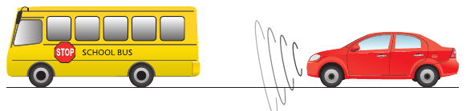
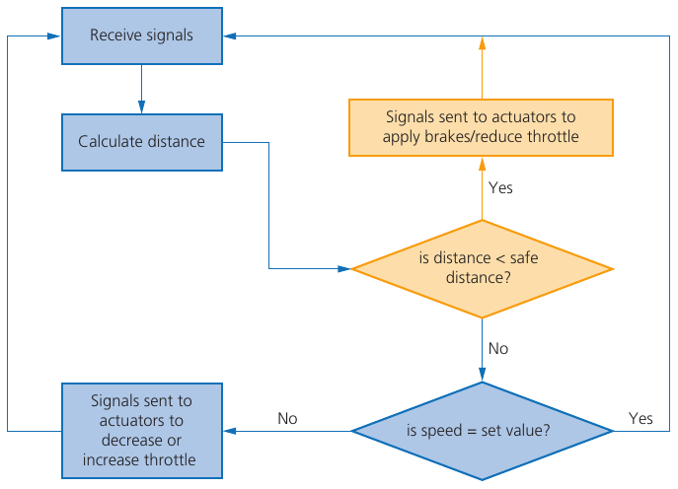
Worked example: adaptive cruise control
Activity 2
Explain how the car keeps a safe distance from the vehicle in front. [4]
Model answer - one mark per point
Lasers / sensors in the bumper send out signals continually, which reflect off the vehicle in front
The microprocessor uses the time taken for the signal to return to calculate the distance
It compares the distance with the stored safe distance
If it is less than the safe distance, it sends signals to actuators to apply the brakes / reduce the throttle
If not, it compares the speed with the set speed and adjusts the throttle; the process repeats
Images: Hodder Cambridge IGCSE Computer Science, Chapter 6.
8
Notes:
Walk through the flowchart, then the model answer. Point out how each sentence maps onto a step of the control loop on slide 7.

Slide 9
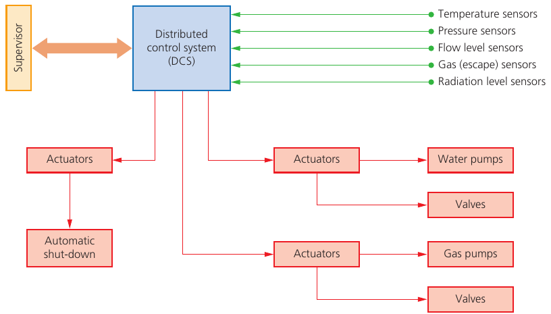
Industry: nuclear power station
Activity 3
Advantages
Faster than a human to take action
Safer - keeps people away from danger
Runs at optimum conditions
Cheaper in the long run (fewer staff 24/7)
Disadvantages
Expensive to set up and test
Unforeseen conditions may not be handled
Risk of cyberattack
Needs enhanced, costly maintenance
1
How it works
Temperature, pressure, flow, gas and radiation sensors send data to a distributed control system (DCS). It compares them with stored values and sends signals to actuators to operate pumps, valves or an automatic shutdown. A supervisor can override.
9
Notes:
Same pattern for paracetamol manufacture and bottling plants (textbook Example 2, Activity 6.1).

Slide 10
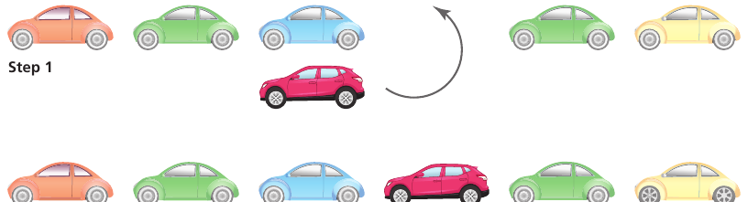
Transport: self-parking cars
Activity 3
Advantages
Cars fit into smaller spaces
Fewer dents and scratches
Safer - stops if a new object (e.g. a child) appears
Very consistent results
Disadvantages
Driver may lose parking skills
Faulty or dirty sensors give false data
May not detect low kerbs
Expensive and needs maintenance
1
How it works
Sensors in the bumpers send signals that reflect off objects; the on-board computer uses the time taken to work out where objects are, then sends signals to actuators that control the steering, brakes and throttle.
10
Notes:
Also mention train signal control (sensors by the track, actuators apply brakes) and aircraft autopilot (flaps, throttle, rudder).

Slide 11
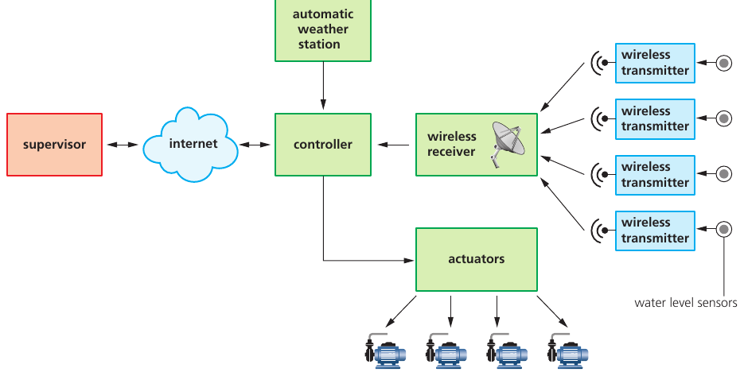
Agriculture: automatic irrigation
Activity 3
Advantages
Lower labour costs - one supervisor for vast areas
Better control of precious water
Faster than checking channels by hand
Safer - no work in 40 °C heat
Disadvantages
Expensive to set up
High maintenance; needs specialist technicians
Cannot detect a blocked or collapsed channel
1
How it works
Water level sensors in the fields send data by wireless to a controller, which also gets weather data. It decides whether to start or stop the pumps and sends signals to actuators. A supervisor monitors remotely.
11
Notes:
The exam pack plough question (0478/13 Oct/Nov 2024) is another agriculture scenario.

Slide 12
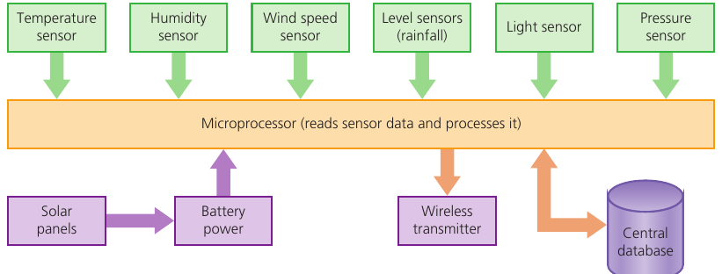
Weather: automated weather station
Activity 3
Advantages
Collects data 24/7, including overnight
Works in remote places and harsh weather
Staff avoid a repetitive task
Creates maintenance jobs
Disadvantages
May de-skill employees
May replace jobs
Expensive to set up and maintain
1
How it works
Temperature, humidity, wind speed, level (rainfall), light and pressure sensors send data to a microprocessor, which processes it and stores it in a database. The only actuator tips the rain-gauge bucket.
12
Notes:
Advantages and disadvantages here use the wording of 0478/13 May/June 2025 Q6(d)-(e): "to the employees" - answers must be from the employees' point of view.

Slide 13
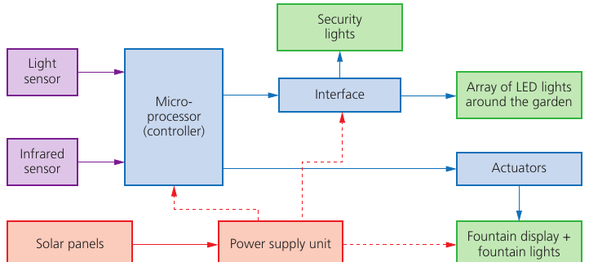
Lighting and gaming
Activity 3
Advantages
Lights only on when needed - less energy
Longer bulb life
Gaming feels more immersive and realistic
Disadvantages
Expensive to set up
Wireless links may be less reliable
Needs maintenance
1
How it works
Lighting: when the light sensor value shows it is dark, or the infrared sensor detects movement, the microprocessor switches the lights or fountain display on. Gaming: accelerometers detect tilt and proximity sensors detect finger position.
13
Notes:
Gaming is short in the textbook: accelerometers and proximity sensors with a microcontroller. Ask students for one advantage and one disadvantage of immersive consoles (Activity 6.6).

Slide 14
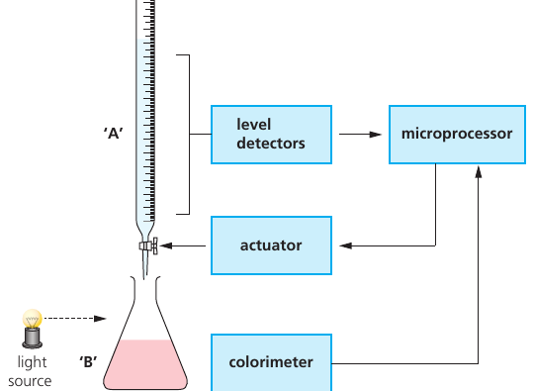
Science: laboratory experiment
Activity 3
Advantages
More consistent, repeatable results
Safer with hazardous chemicals
Several experiments at once
Monitored anywhere in real time
Disadvantages
Less flexible than human technicians
Security risk if data is shared
Expensive equipment
1
How it works
Level sensors measure the liquid added from the burette and a colorimeter checks the colour of the mixture. The microprocessor sends signals to an actuator that opens and closes the burette tap.
14
Notes:
Good example of a non-obvious sensor (colorimeter). Exams will always describe an unfamiliar process - students just need to spot sensor, microprocessor and actuator.

Slide 15
Advantages and disadvantages
Activity 3
Advantages | Disadvantages
Faster to react than a human | Expensive to set up and test
Safer - people kept away from danger | Needs regular, specialist maintenance
Works 24/7 without breaks | Cannot cope with situations it was not programmed for
More accurate and consistent results | Risk of cyberattack or system failure
Saves labour costs in the long run | Can replace jobs / de-skill workers
Frees people from boring, repetitive tasks | Faulty sensors give wrong data
Always make it fit the scenario: who benefits (the farmer, the employees, the driver) and how.
15
Notes:
These generic points work for almost every scenario, but in the exam they must be applied. "Cheaper" alone is weak; "the farmer saves money on labour costs" is credited (0478/13 Oct/Nov 2024 Q5(c)).

Slide 16
Exam technique: the question types
Exam technique
Question type | Marks | What to write | Example from the pack
State what is meant by an automated system | 1 | A system that performs actions without human intervention | Plough, Oct/Nov 2024
Identify a sensor / tick the sensor | 1 | One sensor that fits the scenario - name only | Drone, ATM, robot vacuum
Give another component | 1 | Microprocessor, actuator or storage | Weather station, May/June 2025
Describe the role of the microprocessor | 3 | Receives data, compares with a stored value, sends a signal to act | ATM, plough, air conditioning
Explain how the sensor and microprocessor work together | 3-4 | The full control loop applied to the scenario | Drone [4], weather alert [3]
Give two advantages / one disadvantage | 1-2 | Short points, from the point of view named in the question | Weather station, plough
16
Notes:
Every 6.1 question in the pack fits one of these. The command word and the marks tell students how much to write. All examples are from the supplied pack.

Slide 17
Role of the microprocessor
Exam technique
A greenhouse uses a temperature sensor and a microprocessor to keep the temperature at 25 °C. Describe the role of the microprocessor. [3]
Weak answer (0-1 marks) | Strong answer (3 marks)
"The microprocessor controls the temperature." | It receives the temperature data from the sensor (after ADC conversion).
"It turns the heater on when it is cold." | It compares the reading with the stored value of 25 °C.
"It makes sure the plants are OK." | If it is below 25 °C, it sends a signal to the actuator to switch the heater on; if it matches, no action. This repeats continuously.
Use the key verbs: receives - compares - sends a signal - repeats. Always include the stored value from the question.
17
Notes:
Model answer is for a greenhouse (not in the worksheet) so students can transfer the structure. Mark schemes repeatedly credit: receives data from the sensor; compares it with a stored/preset value; sends a signal to an actuator if outside range; no action if within range; repeats continuously.

Slide 18
Advantages and linked questions
Exam technique
1
Answer from the right point of view
2
One idea per mark
"Give two advantages to the employees" - working overnight / outdoors / repetitive tasks, not "the company saves money".
Two advantages = two different ideas. "Faster" and "quicker" are the same idea.
One scenario, many topics - the weather station question (0478/13 May/June 2025):
Part | Asks about | Topic
(a)-(c)(i) | Components, sensors, how the alert is detected | 6.1 automated systems
(c)(ii) | Serial simplex transmission | 2.1 data transmission
(d)-(e) | Advantages and disadvantages to employees | 6.1 automated systems
(f) | Machine learning to predict weather | 6.3 artificial intelligence
18
Notes:
Scenario questions usually continue into other topics: embedded systems (3.1), robotics (6.2), AI and machine learning (6.3), data transmission (2). The weather station question in the pack goes 6.1 -> 2.1 (serial simplex) -> 6.3 (machine learning). Recognise which topic each part is testing.

Slide 19
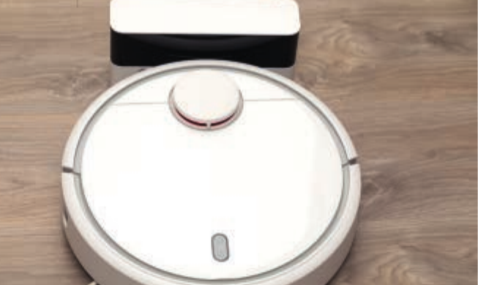
Guided practice
Activity 4
Task 2: definitions and choosing sensors
Task 3: the control loop - drone, air conditioning, ATM, weather alert, plough
Task 4: advantages and disadvantages in a scenario
Task 5 (extension): embedded systems and a 6-mark greenhouse design
Check your work against the answer key when your teacher shares it
19
Notes:
About 25 minutes for Tasks 2-4; Task 5 is extension or homework.

Slide 20
Common misconceptions
Plenary
Misconception | Why it is wrong
"The sensor decides what to do." | The sensor only takes readings. The microprocessor compares and decides.
"The microprocessor turns the motor." | It sends a signal to an actuator, which causes the movement.
"Automated means no humans are involved at all." | Humans often monitor and can override - they are just not needed to run it.
"Sensors only turn on when something happens." | Sensors take readings continually; the process repeats.
"It is cheaper" is enough for a mark. | Say who saves and how: "the farmer saves on labour costs".
20

Slide 21
Exit question
Plenary
A school installs automatic lighting in the car park.
1. Identify a suitable sensor. [1]
2. Describe the role of the microprocessor. [3]
3. Give one advantage to the school of using an automated system. [1]
21
Notes:
Answers: 1 light sensor (accept infrared/motion for detecting people). 2 Sensor sends data continually; microprocessor compares with a stored light value; if it is darker than the stored value it sends a signal to switch the lights on; otherwise no action; repeats. 3 e.g. lights only on when needed so less energy is used; no one has to switch the lights on and off.

Slide 22
In this lesson, you
Summary
Defined an automated system: actions without human intervention
Explained how sensors, a microprocessor and actuators work together in a control loop
Chose suitable sensors for different scenarios
Compared advantages and disadvantages across industry, transport, agriculture, weather, gaming, lighting and science
Practised every type of 6.1 exam question using official marking points
Next lesson: 6.2 robotics.
22

